Slide 1
CS-4301
Compiler Construction
Week 01
Lecture
National University of Computer and Emerging Sciences, Islamabad

Slide 2
Online course Content & Coordination
Google Classroom: CS-4031 Compiler Construction
Class Code: sijz3z3

Slide 3
Course Instructor’s and TA’s Information
Course Instructor: Amna Irum
E-mail: amna.irum@nu.edu.pk
Office : CS block C-110
Office Hours
  1000 – 1245 hrs (Monday, Wednesday)
  0845 – 1000 hrs (Tuesday, Thursday)
TA: To be decided

Slide 4
Text book and reference material
Compiler Construction: Principles and Practice
by Kenneth C. Louden
Compilers Principles, Techniques, and Tools
by Alfred V. Aho, Ravi Sethi, Jeffrey D. Ullman

Slide 5
Course Learning Outcomes
Translate and interpret computer languages,
The basic theory of compilers.
Evaluate the issues involved in implementing a compiler
Better knowledge about how a compiler works
Design parsers and compilers for any language

Slide 6
Compilers and Interpreters
  Translation of a program written in a source language into a semantically equivalent program written in a target language
Input
Source
Program
Compiler
Target
Program
Error messages
Output

Slide 7
Why we use high-level language for programming?
  Notations used by programming languages is closer to the way humans think about problems.
  The compiler can spot some obvious programming mistakes.
  Programs written in a high-level language tend to be shorter than equivalent programs written in machine language.
  The same program can be compiled to many different machine languages and, hence, be brought to run on many different machines.

Slide 8
Why learn about compilers?
Compilers are important tools for programmers and computer scientists.
The techniques used for constructing a compiler are useful for other purposes as well.
There is a good chance that a programmer or computer scientist will need to write a compiler or interpreter for a domain-specific language.

Slide 9
The Evolution of Programming Language
Classification by generation
First-generation languages: machine languages
Second-generation : assembly languages
Third-generation : higher-level languages like Fortran, Cobol, Lisp, C, C++, C#, and Java.
Fourth-generation languages: languages designed for specific applications like NOMAD for report generation, SQL for database queries, and Postscript for text formatting.
Fifth-generation language has been applied to logic- and constraint-based languages like Prolog and OPS5.

Slide 10
Impacts on Compilers
The advances in programming languages placed new demands on compiler writers.
Compiler writers would take maximal advantage of the new hardware capabilities.
Good software-engineering techniques are essential for creating and evolving modern language processors.
Notes:
The design of programming languages and compilers are intimately related, the advances in programming languages placed new demands on compiler writers. They had to devise algorithms and representations to translate and support the new language features.
Since the 1940's, computer architecture has evolved as well. Not only did the compiler writers have to track new language features, they also had to devise translation algorithms that would take maximal advantage of the new hardware capabilities.
Compilers can help promote the use of high-level languages by minimizing the execution overhead of the programs written in these languages.
Compilers are also critical in making high-performance computer architectures effective on users' applications. In fact, the performance of a computer system is so dependent on compiler technology that compilers are used as a tool in evaluating architectural concepts before a computer is built.
Compiler writing is challenging. A compiler by itself is a large program.
Moreover, many modern language-processing systems handle several source languages and target machines within the same framework; that is, they serve as collections of compilers, possibly consisting of millions of lines of code. Consequently, good software-engineering techniques are essential for creating and evolving modern language processors.
A compiler must translate correctly the potentially infinite set of programs that could be written in the source language. The problem of generating the optimal target code from a source program is undecidable in general; thus, compiler writers must evaluate tradeoffs about what problems to tackle and what heuristics to use to approach the problem of generating efficient code.

Slide 11
Compilers and Interpreters
  Translation of a program written in a source language into a semantically equivalent program written in a target language
Input
Source
Program
Compiler
Target
Program
Error messages
Output

Slide 12
Compilers and Interpreters (cont’d)
“Interpretation”
  Performing the operations implied by the source program
Source
Program
Interpreter
Output
Input
Error messages

Slide 13
Compiler vs. Interpreter
Compiler
Interpreter
Take single instruction as input
It is Slower
No intermediate code is generated
Required less memory As no intermediate code is generated
Every time higher level program is converted into lower level program.
Errors are displayed for every instruction interpreted.
Debugging is easy.
Ex: python, Ruby, basic.
Takes Entire program as input
It is Faster
intermediate object code is generated.
Required more memory Due to intermediate object code
Program not need compile every time
Errors are displayed after entire program is checked.
Debugging is comparatively hard.
Ex: C, C++.

Slide 14
Hybrid compiler
  Compilation and interpretation may be combined to implement a programming language:
    The compiler may produce intermediate-level code which is then interpreted rather than compiled to machine code.
    Ex: java
Source Program
Translator
(Compiler)
Intermediate Program
Virtual machine
(Interpreter)
Output
Input

Slide 15
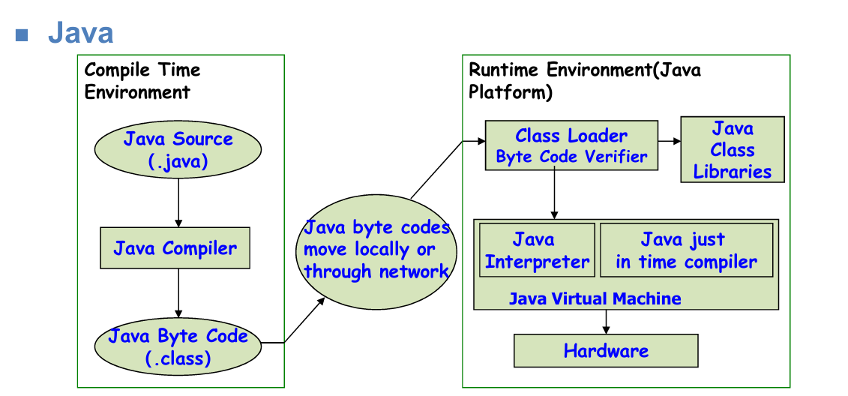

Slide 16
Preprocessors, Compilers, Assemblers, and Linkers
Skeletal Source Program
Preprocessor
Source Program
Compiler
Try for example:
gcc -v myprog.c
Target Assembly Program
Assembler
Relocatable Object Code
Linker
Libraries and
Relocatable Object Files
Absolute Machine Code

Slide 17
Accompanies of a compiler
Editor is the environment where you can type-in your source code, sometimes with highlights, automatic matching, or intelligent completion.
Preprocessor provides the first pass of compilation. It processes include-files, conditional compilation instructions and macros, delete comments, etc.
Assembler performs the third stage of compilation. It takes the assembly source code and produces an assembly listing with offsets. The assembler output is stored in an object file.
Linker performs the final stage of compilation. It takes one or more object files or libraries as input and combines them to produce a single (usually executable) file.
Loader loads the executable code into the memory

Slide 18
The Compilation Process
Source code
Scanner
Tokens
Parser
Symbol
Table
Syntax Tree
Semantics Analyzer
Annotated Tree
Source Code Optimizer
Intermediate code
Error
Handler
Code Generator
Target code
Target Code Optimizer
Target code

Slide 19
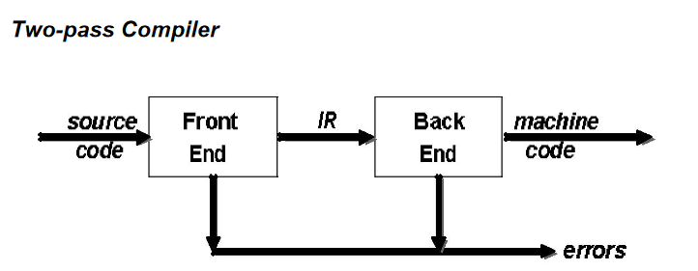
Two Pass Compiler

Slide 20
Two Pass Compiler
An immediate advantage of this scheme is that it admits multiple front ends and multiple passes.
The algorithms employed in the front end have polynomial time complexity
Backend algorithms are NP-complete.

Slide 21
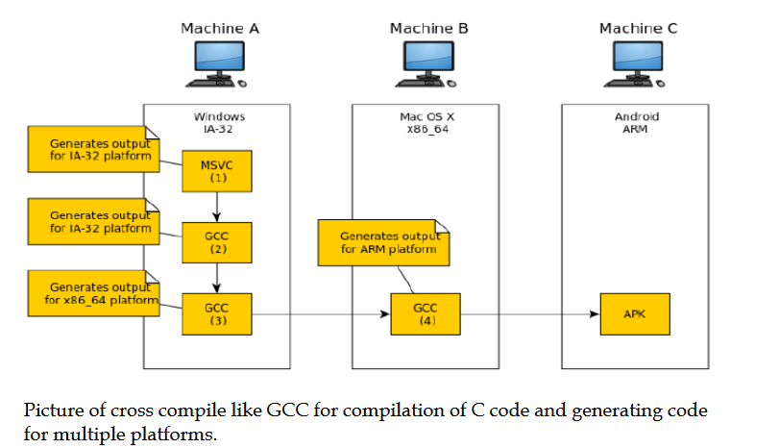

Slide 22
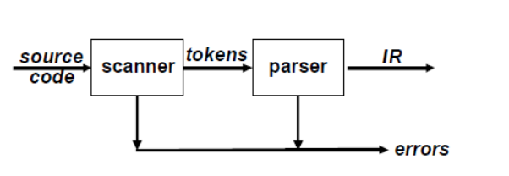
Front End
The front end recognizes legal and illegal programs presented to it. When it
encounters errors, it attempts to report errors in a useful way.

Slide 23
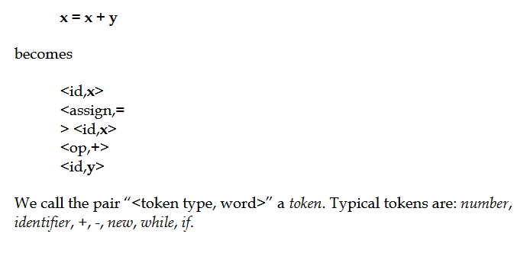
Scanner
The scanner takes a program as input and maps the character stream into “words” that are the basic unit of syntax. It produces pairs – a word and its part of speech.

Slide 24
The Scanner
Lexical analysis: it collects sequences of characters into meaningful units called tokens
An example: a[index]=4+2
    a identifier
    [ left bracket
    index identifier
    ] right bracket
    = assignment
    4 number
    + plus sign
    2 number
Other operations: it may enter literals into the literal table

Slide 25
Parser
The parser takes in the stream of tokens, recognizes context- free syntax and reports errors.
It guides context-sensitive (“semantic”) analysis for tasks like type checking. The parser builds IR for source program.

Slide 26
Context Free Grammars
The syntax of most programming languages is specified using Context-Free Grammars (CFG). Context- free syntax is specified with a grammar G=(S,N,T,P)
where
S is the start symbol
N is a set of non-terminal symbols
T is set of terminal symbols or words
P is a set of productions or rewrite rules

Slide 27
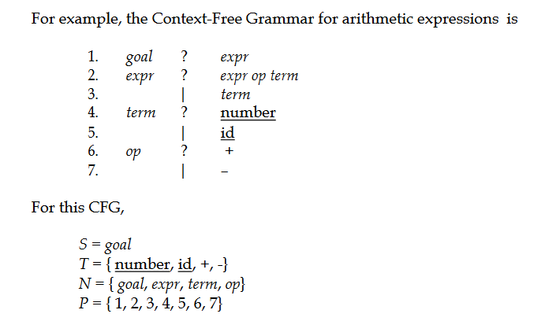

Slide 28
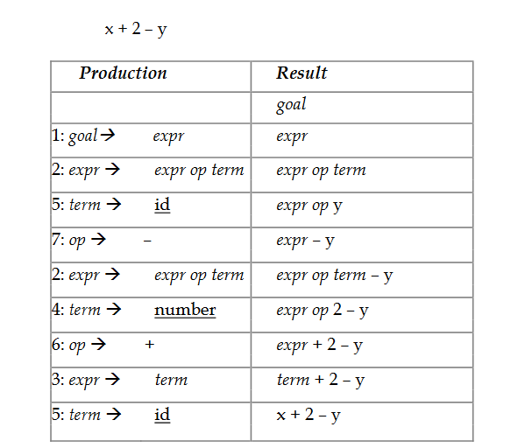

Slide 29
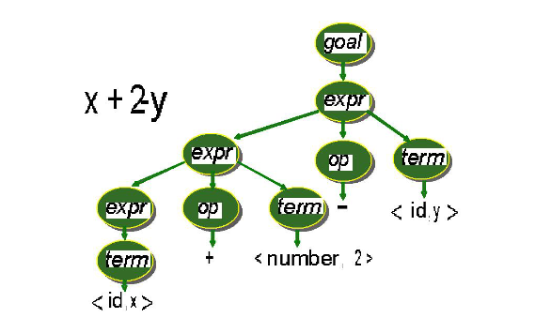
A parse can be represented by a tree: parse tree or syntax tree.

Slide 30
The Parse Tree
a[index]=4+2
expression
Assign-expression
expression = expression
subscript-expression additive-expression
Expression [ expression ] expression + expression
identifier identifier number number
a index 4 2

Slide 31
The Syntax Tree
a[index]=4+2
Assign-expression
subscript-expression additive-expression
identifier identifier number number
a index 4 2

Slide 32
The Semantic Analyzer
The semantics of a program are its “meaning”, as opposed to its syntax, or structure
  It determines some of its running time behaviors prior to execution
Static Semantics: declarations and type checking
Attributes: The extra pieces of information computed by semantic analyzer
An example: a[index]=4=2
  The syntax tree annotated with attributes

Slide 33
The Annotated Syntax Tree
Assign-expression
subscript-expression additive-expression
integer integer
identifier identifier number number
a index 4 2
array of integer integer integer integer

Slide 34
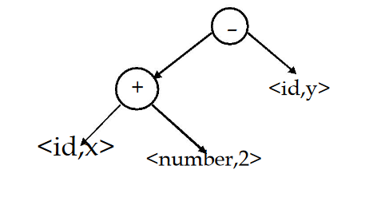
AST-Abstract Syntax Tree
The parse tree contains a lot of unneeded information.
Compilers often use an abstract syntax tree (AST).
AST summarizes grammatical structure without the details of derivation. ASTs are one kind of intermediate representation (IR)

Slide 35
Back End
The back end of the compiler translates IR into target machine code.
It decides which values to keep in registers in order to avoid memory access; memory access is far slower than register access.

Slide 36
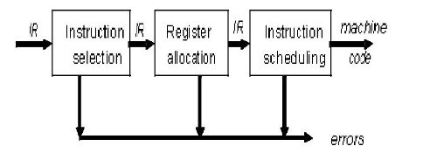
Back End

Slide 37
Instruction Selection
The back end is responsible for instruction selection so as to produce fast and compact code.
Modern processors have a rich instruction set.
Usually, instruction selection is viewed as a pattern matching problem that can be solved by dynamic programming based algorithms.

Slide 38
Register Allocation
Registers in a CPU play an important role for providing high speed access to operands.
Memory access is an order of magnitude slower than register access. The back end attempts to have each operand value in a register when it is used.
Back end has to manage a limited set of resources when it comes to the register file.
Optimal register allocation is NP-Complete.

Slide 39
Instruction Scheduling
Modern processors have multiple functional units.
The back end needs to schedule instructions to avoid hardware stalls and interlocks.
The generated code should use all functional units productively. Optimal scheduling is NP-Complete in nearly all cases.

Slide 40
The Source Code Optimizer
The earliest point of most optimization steps is just after semantic analysis
The code improvement depends only on the source code, and as a separate phase
Individual compilers exhibit a wide variation in optimization kinds as well as placement
An example: a[index]=4+2
  Constant folding performed directly on annotated tree
  Using intermediate code: three-address code, p-code

Slide 41
Annotated Tree Without Optimization
Assign-expression
subscript-expression additive-expression
integer integer
identifier identifier number number
a index 4 2
array of integer integer integer integer

Slide 42
Optimized Annotated Tree
Assign-expression
subscript-expression
integer
identifier identifier number
a index 6
array of integer integer integer

Slide 43
Optimization on Intermediate Code
t = 4 + 2
a[index]=t
t = 6
a[index]=t
a[index]=6

Slide 44
The Code Generator
It takes the intermediate code or IR and generates code for target machine
The properties of the target machine become the major factor:
  Using instructions that exist on target machines
  How to make representation of data i.e. how many bytes and words will be allocated to a give type of a variable

Slide 45
The Target Code Optimizer
It improves the target code generated by the code generator:
  By choosing addressing modes to increase performance
  Replacing slow instructions with faster ones
  eliminating redundant operations

Slide 46
Principal Data Structures Used in Compilers
TOKENS
  A scanner collects characters into a token, as a value of an enumerated data type for tokens
  May also preserve the string of characters or other derived information, such as name of identifier, value of a number
  A single global variable or an array of tokens
THE SYNTAX TREE
  A standard pointer-based structure generated by parser
  Each node represents information collected by parser, which maybe dynamically allocated in symbol table
  The node requires different attributes depending on kind of language structure, which may be represented as variable record

Slide 47
Principal Data Structures Used in Compilers (Continue…)
THE SYMBOL TABLE
  Keeps information associated with identifiers: function, variable, constants, and data types
  Interacts with almost every phase of compiler
  Access operation need to be constant-time
  One or several hash tables are often used
THE LITERAL TABLE
  Stores constants and strings, reducing size of program
  Quick insertion and lookup are essential
  If a literal is used more than once (as they often are in a program), we still want to store it only once

Slide 48
Principal Data Structures Used in Compilers (Continue…)
INTERMEDIATE CODE
  Kept as an array of text string, a temporary text, or a linked list of structures, depending on kind of intermediate code (e.g. three-address code and p-code)
  Should be easy for reorganization
TEMPORARY FILES
  Holds the product of intermediate steps during compiling
  Solve the problem of memory constraints or back-patch addressed during code generation

Slide 49
Error Handling
Static (or compile-time) errors must be reported by a compiler
  Generate meaningful error messages and resume compilation after each error
  Each phase of a compiler needs different kind of error handing
  Must handle a wide range of errors
  Must handle multiple errors.
  Must not get stuck.
  Must not get into an infinite loop

Slide 50
Error Handling (Continue…)
Exception handling
  Generate extra code to perform suitable runtime tests to guarantee all such errors to cause an appropriate event during execution

Slide 51
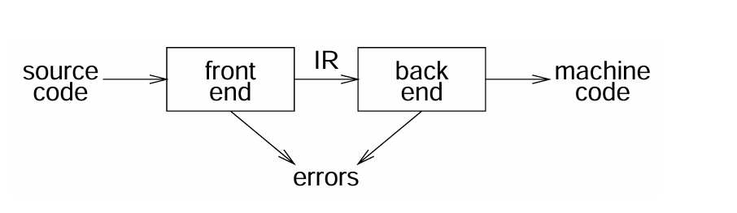
Two pass compiler
Implications:
  intermediate representation (IR)
  front end maps legal code into IR
  back end maps IR onto target machine
  simplify retargeting
  allows multiple front ends
  multiple passes → better code

Slide 52
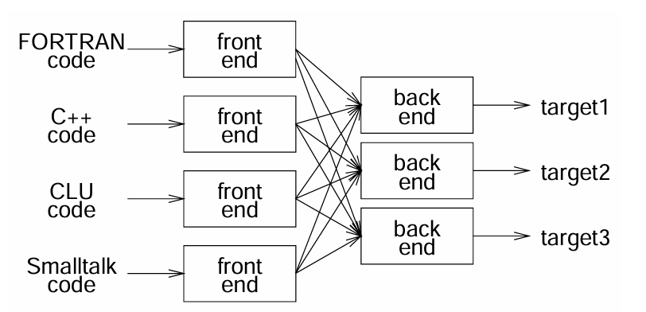
Use of Two pass compiler architecture
Can we build n x m compilers with n + m components?

Slide 53
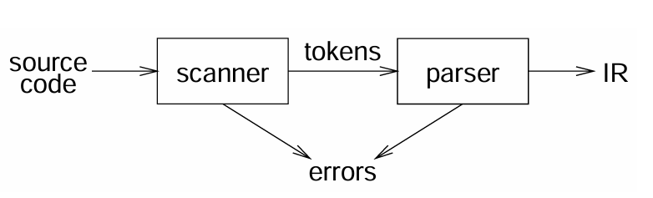
Front end
Responsibilities:
    recognize legal procedure
    report errors
    produce IR
    preliminary storage map
    shape the code for the back end
Much of front end construction can be automated

Slide 54
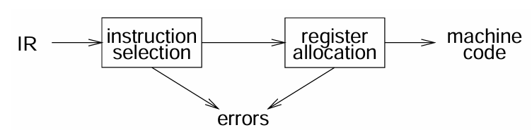
Back end
Responsibilities
    translate IR into target machine code
    choose instructions for each IR operation
    decide what to keep in registers at each point
    ensure conformance with system interfaces
    Automation has been less successful here

Slide 55
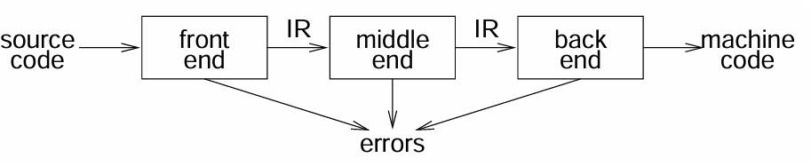
Three Pass Compiler
    Code improvement
    analyzes and changes IR
    goal is to reduce runtime
    must preserve values

Slide 56
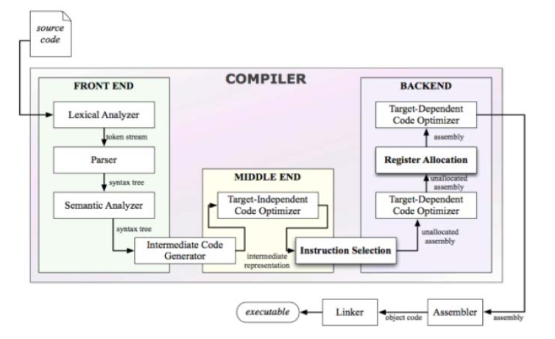

Slide 57
Compiler-Construction Tools
Parser generators that automatically produce syntax analyzers from a grammatical description of a programming language.
Scanner generators that produce lexical analyzers from a regular-expression description of the tokens of a language.
Syntax-directed translation engines that produce collections of routines for walking a parse tree and generating intermediate code.
Code-generator generators that produce a code generator from a collection of rules for translating each operation of the intermediate language into the machine language for a target machine.
Data-flow analysis engines that facilitate the gathering of information about how values are transmitted from one part of a program to each other part. Data-flow analysis is a key part of code optimization.
Compiler-construction toolkits that provide an integrated set of routines for constructing various phases of a compiler.

Slide 58
The Phases of a Compiler
Phase | Output | Sample
Programmer | Source string | A=B+C;
Scanner (performs lexical analysis) | Token string | ‘A’, ‘=’, ‘B’, ‘+’, ‘C’, ‘;’ And symbol table for identifiers
Parser (performs syntax analysis based on the grammar of the programming language) | Parse tree or abstract syntax tree | ; | = / \ A + / \ B C
Semantic analyzer (type checking, etc) | Parse tree or abstract syntax tree
Intermediate code generator | Three-address code, quads, or RTL | int2fp B t1 + t1 C t2 := t2 A
Optimizer | Three-address code, quads, or RTL | int2fp B t1 + t1 #2.3 A
Code generator | Assembly code | MOVF #2.3,r1 ADDF2 r1,r2 MOVF r2,A
Peephole optimizer | Assembly code | ADDF2 #2.3,r2 MOVF r2,A

Slide 59
Summary
Language Processors: An integrated software development environment includes many different kinds of language processors such as compilers, interpreters, assemblers, linkers, loaders, debuggers, profilers.
Compiler Phases: A compiler operates as a sequence of phases, each of which transforms the source program from one intermediate representation to another.
  Lexical Analyzer
  Syntax Analyzer
  Semantic Analyzer
  Intermediate Code Generator
  Machine-Independent Code Optimizer
  Code Generator
  Machine-Dependent Code Optimizer
Machine and Assembly Languages: Machine languages were the first generation programming languages, followed by assembly languages. Programming in these languages was time consuming and error prone.

